Slide 1
Francis Kiddle, RDP, HonFRPSL
Chairman, FIP Revenue Commission
www.fip-revenue.org/

Slide 2
Revenues – Exhibiting and Judging
British Philatelic Trust sponsored
ABPS Seminar 23rd February 2013

Slide 3
Definition
A revenue exhibit comprises embossed, imprinted or adhesive tax, fee or credit stamps issued by or under the originating authority of a state or municipal or intermediate government authority

Slide 4
What can be included
Revenues that pay registration, general duty, consular, weights & measures, licenses, judicial, assurances, receipts, transfers of ownership, bills etc
Postage stamps used as revenues
Postal Orders when the feature is poundage
Savings stamps not currently included

Slide 5
What can be included (2)
Essays, proofs of adopted or rejected designs
Legal documents and postal covers
Varieties of the stamps (paper, printing etc)
Maps, prints and associated materials when such items have direct relation to fiscal services

Slide 6
What can be included (3)
The Guidelines state that it is acceptable to study one category of duty (say national insurance tax) with stamps that may come from different countries
Guidelines also state that revenue exhibits should never be considered as thematic exhibits

Slide 7
Lack of Information
Revenue Class is most recent full FIP class and has not got the literature background that other classes enjoy
One source of information is Revenue Society website – www.revenue society.org.uk

Slide 8
Complexity of the Subject
For certain countries the number of issues are, at least, an order of magnitude larger than for postage stamp issues
For example, Barefoot simplified GB revenues lists over 6,500 examples excluding embossed, another vast field

Slide 9
Marking scheme
Treatment (20) and Importance (10) 30
Knowledge and research (35) 35
Condition (10) and Rarity (20) 30
Presentation (5) 5
TOTAL: 100

Slide 10
Treatment (1)
Differs from Traditional in that instead of solely the prepayment of postal charges, the revenue stamp could be used to collect money from many different sources.
The scope can be significantly wider with new taxes being introduced due to social changes

Slide 11
Treatment (2)
Completeness is often not possible.
For example, the Beer Duty stamps of Australia are recorded but only one third have been found to date
Certain revenue types can not be found on documents (eg GB silver spoon tax!)

Slide 12
Importance
Municipal tax will not be so important as state tax nor as government tax
Certain countries (USA, UK etc) are considered more important than others.

Slide 13
FIP Definitions
Knowledge is the degree of knowledge of the exhibitor as expressed by the items chosen for display and their related description
Personal Study is the proper analysis of the items chosen for display
Research is the presentation of new facts related to the chosen subject

Slide 14
Knowledge
Basic knowledge on the stamps issued – printer, watermark, date and numbers issued, varieties, proofs, artwork etc
Documents – to score high marks it is very important to indicate the reason for the tax (eg documentary, judicial, bill, consular etc) and to explain the revenue rate.

Slide 15
Knowledge (2)
Literature and source information – revenues were studied up until the 1910s, and then not seriously until recent times. Thus there is not the background information that is available, say, for postage stamps.
Rate information is difficult to find.
If research is demonstrated, it should be rewarded

Slide 16
Knowledge (3)
Where to find information on rates:
Government Gazettes – a number are now appearing on the web
Revenue Society and FIP Revenue Commission websites – look at exhibits shown

Slide 17
Knowledge (4)
John Dahl’s method – obtain tax literature from country (in his case Portugal);
Scan text and OCR it;
Google translate the text

Slide 18
Back Creek Gold Mining Company £5 Script Dated 16th November 1870

Slide 19
Back Creek Gold Mining Co £5 Script dated 16 Nov 1870
Five £5 shares valued at £4-4-6 each, tax paid by 1d and 4d Perf 12
Perforations by J Walsh & Sons, Hobart under contract for Post Office

Slide 20
Back Creek Gold Mining Co £5 Script dated 16 Nov 1870
Five £5 shares valued at £4-4-6 each, tax paid by 1d and 4d Perf 12
perforations by J Walsh & Sons, Hobart under contract. 1.11.1870 Post Office Stamp Act - Script shares tax 1d for up to £5 for every share, £5x5 = 5d duty

Slide 21
What is a Scrip Certificate
A Scrip Issue is a process of creating new shares which are given free of charge to existing shareholders.
It can be done in lieu of a dividend, which may reduce tax liability as it is a capital gain rather than income
As it has no value, per se, tax is levied at 1d for up to £5 nominal value of the Certificate

Slide 22
1918-1920 Provisional Overprints The 5d overprint met a new rate introduced on 1.1.1918
5d for where the sum received exceeds £100 for the first £100; every additional £100 or part thereof charged at 6d - £237.13.6 = 5d + 2x 6d = 1/5

Slide 23
Condition
By their nature, revenue stamps may be in poor condition. Stamps often are cut, nailed or stapled to documents so as to prevent their reuse – Beer duty especially so.
Key factor – Relative condition

Slide 24
Rarity
How plentiful?
What is relative scarcity of that country?
Some taxes are much rarer than others due to survival rates differing.
There are many ‘unique’ items to be found.

Slide 25
Presentation
Clear and concise
Revenues often generate problems due to size of documents and so exhibitors have to innovative.

Slide 27
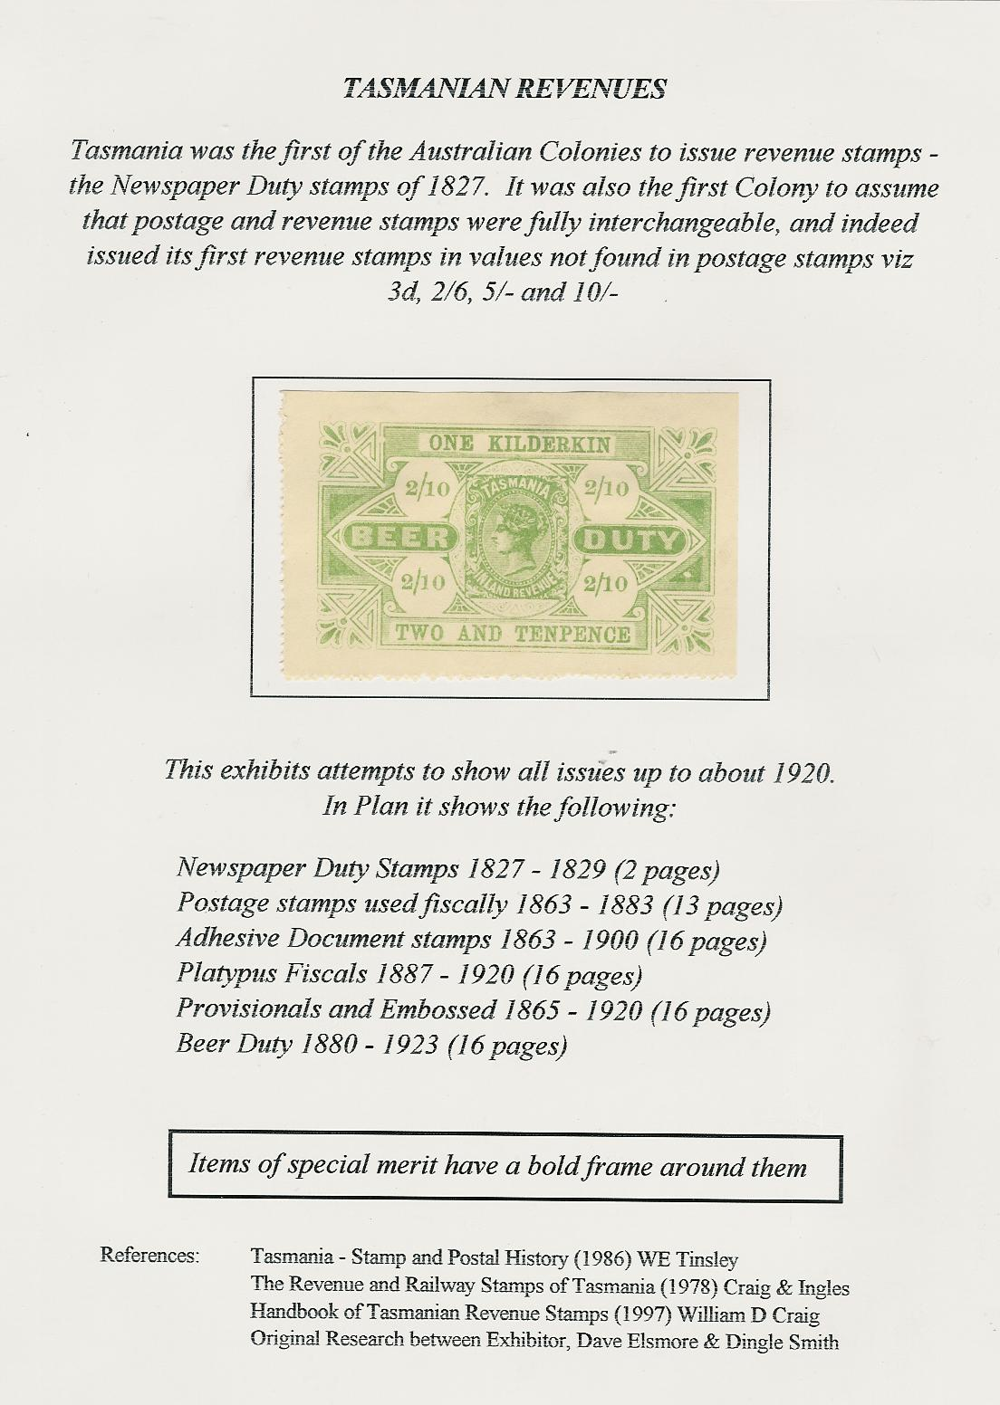

Slide 28
